Slide 1
Announcements
John Oliver “Last Week Tonight” on AI, ChatGPT, etc. (NSFW)
Latin American and Caribbean states announce support for a treaty banning some types of autonomous weapons and regulating others
United States, China, and many other countries announce support for a voluntary code of conduct on responsible use of autonomous weapons
Midterm next Monday (March 6) 8-10pm (more details++ on ed)

Slide 2
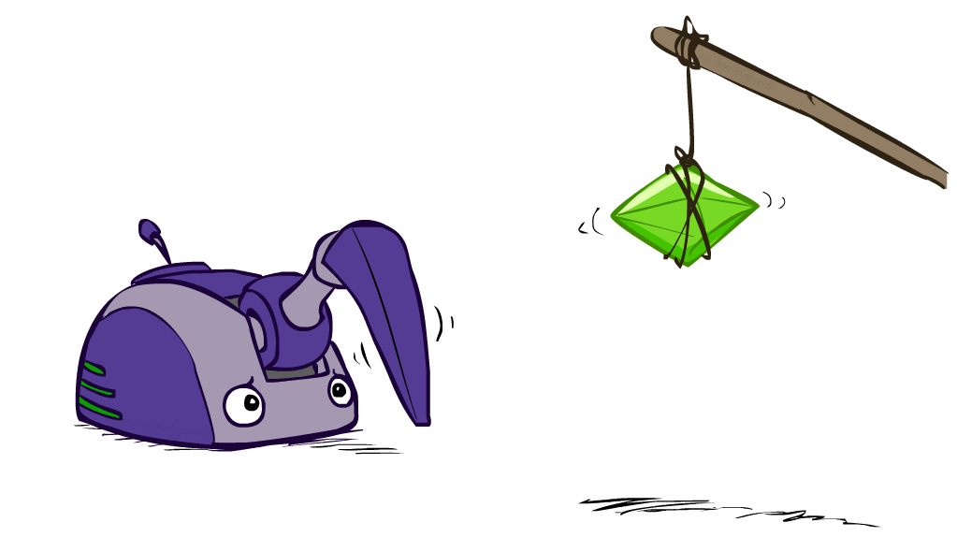
CS 188: Artificial Intelligence
Reinforcement Learning I
Instructors: Stuart Russell and Peyrin Kao
University of California, Berkeley
Notes:
Please retain proper attribution and the reference to ai.berkeley.edu. Thanks!

Slide 3
Reinforcement learning
What if the MDP is initially unknown? Lots of things change!
Exploration: you have to try unknown actions to get information
Exploitation: eventually, you have to use what you know
Regret: early on, you inevitably “make mistakes” and lose reward
Sampling: you may need to repeat many times to get good estimates
Generalization: what you learn in one state may apply to others too

Slide 4
Reinforcement Learning
Agent
State: s
Reward: r
Actions: a
Environment
Basic idea:
Learn how to maximize expected rewards based on observed samples of transitions
Not unlike the basic problem faced by all living things
Notes:
Show robot-soccer learning to walk videos (UT Austin):
? Show snake robot:

Slide 5
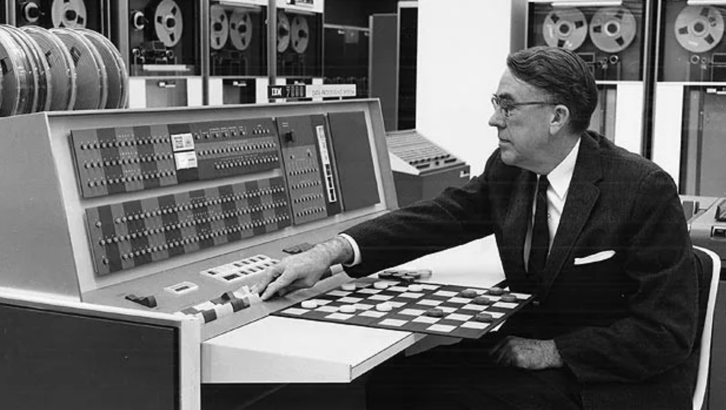
Example: Samuel’s checker player (1956-67)

Slide 6
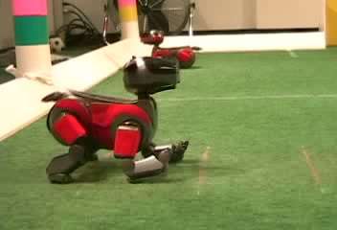
Example: Learning to Walk
Initial
[Kohl and Stone, ICRA 2004]
[Video: AIBO WALK – initial]

Slide 7
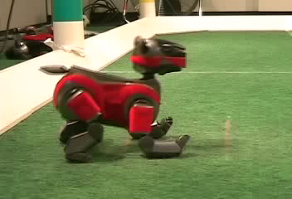
Example: Learning to Walk
Finished
[Kohl and Stone, ICRA 2004]
[Video: AIBO WALK – finished]

Slide 8
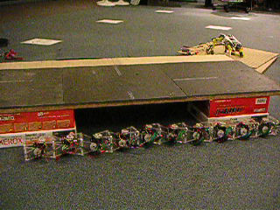
Example: Sidewinding
[Andrew Ng]
[Video: SNAKE – climbStep+sidewinding]

Slide 9
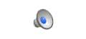
Example: Breakout (DeepMind)
[© TwoMinuteLectures]
Notes:
Note: not true that it just maximizes score; also tries to minimize lives lost; also a tiny penalty for moving the paddle

Slide 10
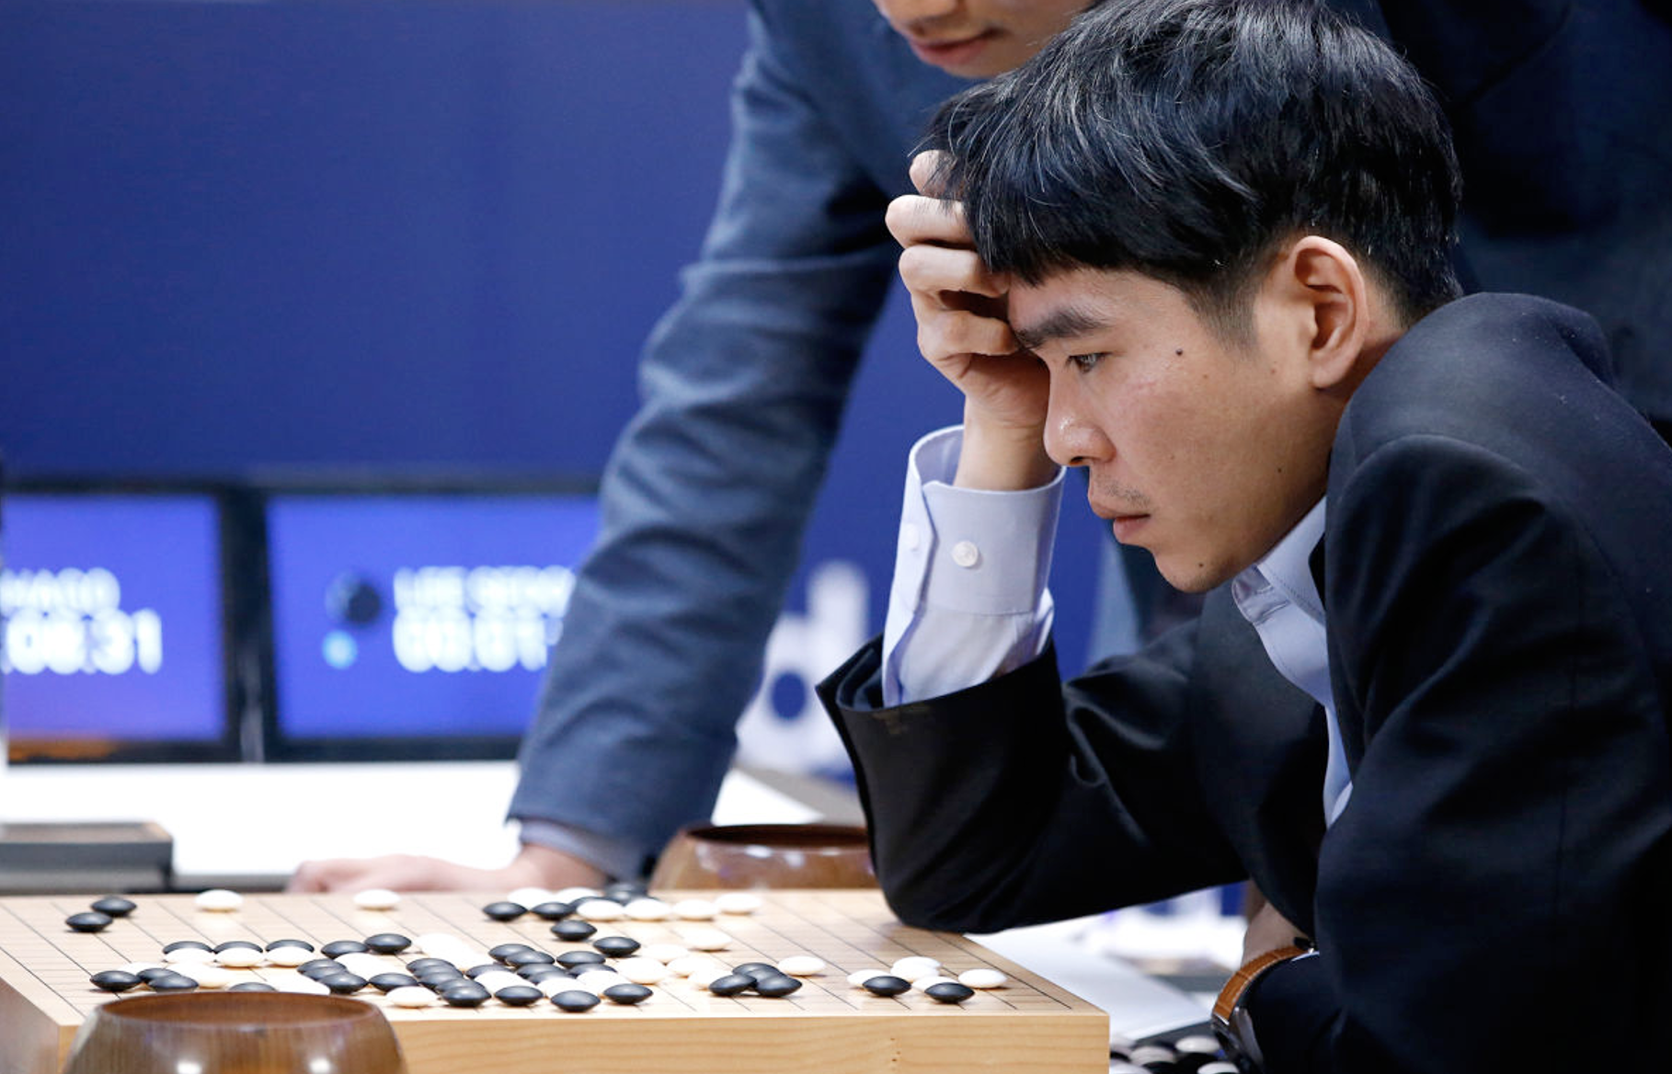
Example: AlphaGo (2016)

Slide 11
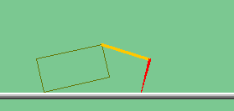
The Crawler!
[Demo: Crawler Bot (L10D1)] [You, in Project 3]
Notes:
At times no reward accumulated at all, just sitting still

Slide 12
Video of Demo Crawler Bot

Slide 13
Reinforcement Learning
Still assume a Markov decision process (MDP):
A set of states s ∈ S
A set of actions (per state) A(s)
A transition model T(s,a,s’)
A reward function R(s,a,s’)
Still looking for a policy π(s)
New twist: don’t know T or R
I.e. we don’t know which states are good or what the actions do
Must explore new states and actions -- to boldly go where no Pacman has gone before

Slide 14
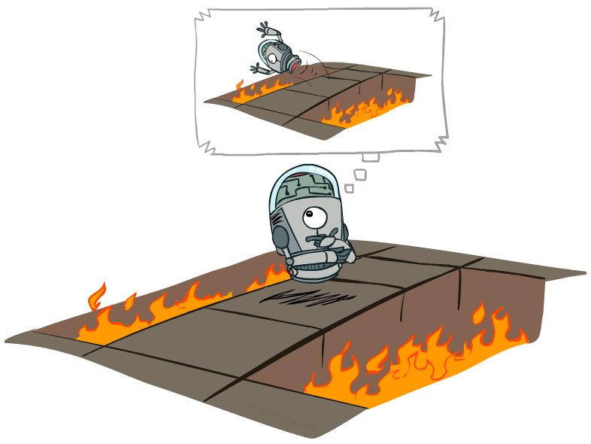
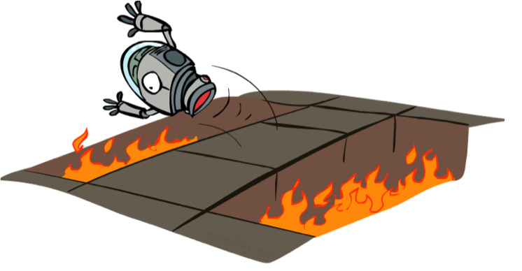
Offline (MDPs) vs. Online (RL)
Offline Solution
Online Learning

Slide 15
Approaches to reinforcement learning
Model-based: Learn the model, solve it, execute the solution
Learn values from experiences, use to make decisions
Direct evaluation
Temporal difference learning
Q-learning
Learn policies directly (see AIMA4e Section 22.5)

Slide 16
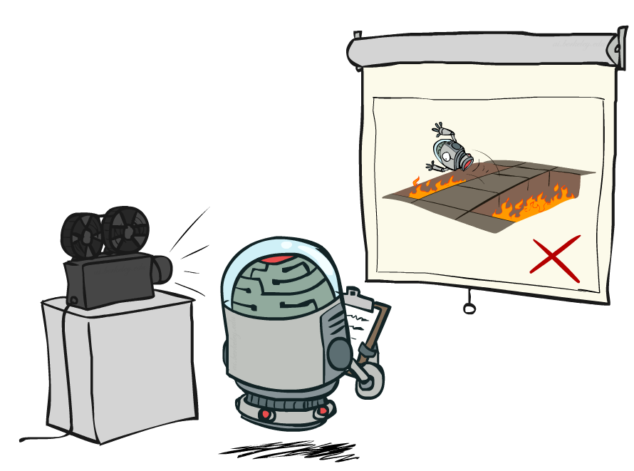
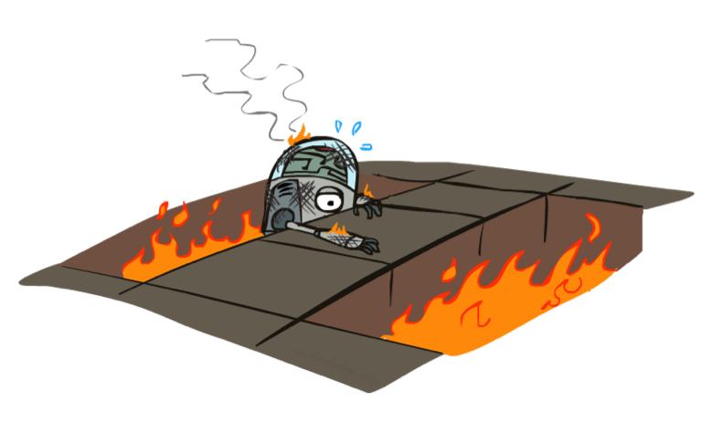
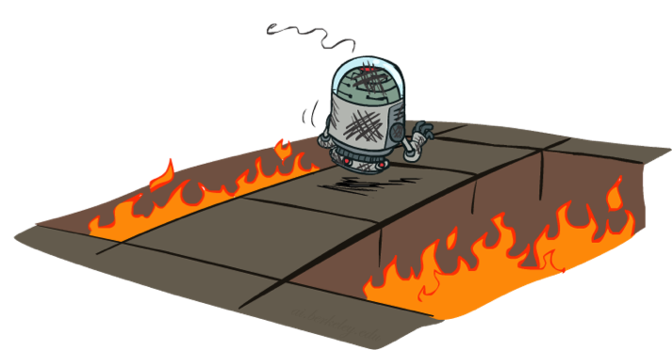
Passive vs Active Reinforcement Learning

Slide 17

Model-Based RL

Slide 18


Model-Based Learning
Model-Based Idea:
Learn an approximate model based on experiences
Solve for values as if the learned model were correct
Step 1: Learn empirical MDP model
Count outcomes s’ for each s, a
Directly estimate each entry in T(s,a,s’) from counts
Discover each R(s,a,s’) when we experience the transition
Step 2: Solve the learned MDP
Use, e.g., value or policy iteration, as before

Slide 19
Example: Model-Based Learning
Input Policy π
Observed Episodes (Training)
Learned Model
Episode 1
Episode 2
T(s,a,s’).
T(B, east, C) = 1.00
P(C, east, D) = 0.75
P(C, east, A) = 0.25
…
R(s,a,s’).
R(B, east, C) = -1
R(C, east, D) = -1
R(D, exit, x) = +10
…
T(s,a,s’)
 | A
B | C | D
 | E
B, east, C, -1
C, east, D, -1
D, exit, x, +10
B, east, C, -1
C, east, D, -1
D, exit, x, +10
Episode 3
Episode 4
R(s,a,s’)
E, north, C, -1
C, east, D, -1
D, exit, x, +10
E, north, C, -1
C, east, A, -1
A, exit, x, -10
Assume: γ = 1

Slide 20
Pros and cons
Pro:
Makes efficient use of experiences (low sample complexity)
Con:
May not scale to large state spaces
Learns model one state-action pair at a time (but this is fixable)
Cannot solve MDP for very large |S| (also somewhat fixable)
Much harder when the environment is partially observable

Slide 21
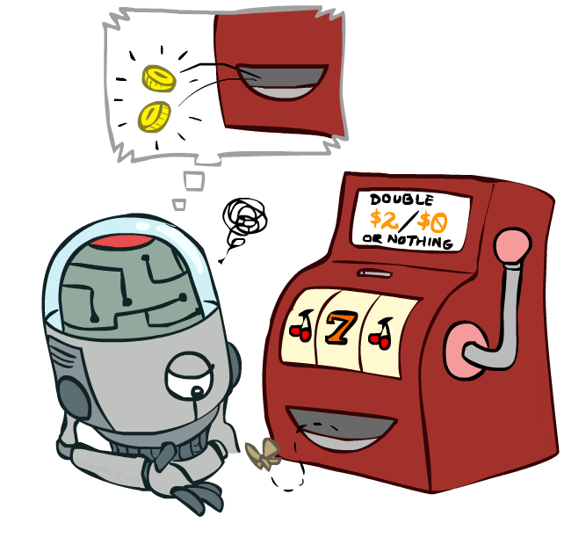
Model-Free Learning

Slide 22
Basic idea of model-free methods
To approximate expectations with respect to a distribution, you can either
Estimate the distribution from samples, compute an expectation
Or, bypass the distribution and estimate the expectation from samples directly

Slide 23
Example: Expected Age
Goal: Compute expected age of cs188 students
Known P(A)
E[A] = ∑_{a} P(a) ⋅ a = 0.35 x 20 + …
Without P(A), instead collect samples [a₁, a₂, … a_{N}]
“Model Based”: estimate P(A):
“Model Free”: estimate expectation
Why does this work? Because eventually you learn the right model.
Why does this work? Because samples appear with the right frequencies.
P^(A=a) = N_{a}/N
E[A] ≈ ∑_{a} P^ (a) ⋅ a
E[A] ≈ 1/N ∑_{i} a_{i}

Slide 24
Passive Reinforcement Learning
Simplified task: policy evaluation
Input: a fixed policy π(s)
You don’t know T and R
Goal: learn the state values V^{π}(s)

Slide 25
Direct evaluation
Goal: Estimate V^{π}(s), i.e., expected total discounted reward from s onwards
Idea:
Use returns, the actual sums of discounted rewards from s
Average over multiple trials and visits to s
This is called direct evaluation (or direct utility estimation)

Slide 26
Example: Direct Estimation
Input Policy π
Observed Episodes (Training)
Output Values
Episode 1
Episode 2
-10
 | A
B | C | D
 | E
B, east, C, -1
C, east, D, -1
D, exit, x, +10
B, east, C, -1
C, east, D, -1
D, exit, x, +10
 | A
B | C | D
 | E
+8
+4
+10
Episode 3
Episode 4
-2
E, north, C, -1
C, east, D, -1
D, exit, x, +10
E, north, C, -1
C, east, A, -1
A, exit, x, -10
Assume: γ = 1

Slide 27
Problems with Direct Estimation
What’s good about direct estimation?
It’s easy to understand
It doesn’t require any knowledge of T and R
It converges to the right answer in the limit
What’s bad about it?
Each state must be learned separately (fixable)
It ignores information about state connections
So, it takes a long time to learn
Output Values
 | A
B | C | D
 | E
-10
+8
+4
+10
-2
If B and E both go to C under this policy, how can their values be different?
E.g., B=at home, study hard
E=at library, study hard
C=know material, go to exam

Slide 28
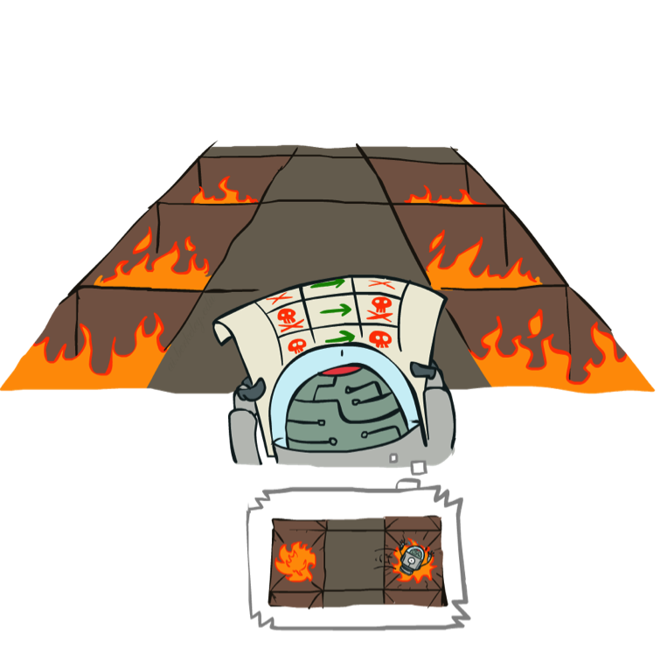
Temporal difference (TD) learning

Slide 29



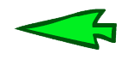

TD as approximate Bellman update
Given a fixed policy, the value of a state is an expectation over next-state values:
V^{π}(s) = ∑_{s’} T(s,π(s),s’) [R(s,π(s),s’) + γV^{π}(s’) ]
Idea 1: Use actual samples to estimate the expectation:
sample₁ = R(s,π(s),s₁’) + γV^{π}(s₁’)
sample₂ = R(s,π(s),s₂’) + γV^{π}(s₂’)
…
sample_{N} = R(s,π(s),s_{N}’) + γV^{π}(s_{N}’)
V^{π}(s) ← 1/N ∑_{i} sample_{i}

Slide 30
TD as approximate Bellman update
Idea 2: Update value of s after each transition s,a,s’,r :
Update V^{π} ([3,1]) based on R([3,1],up,[3,2]) and γV^{π}([3,2])
Update V^{π} ([3,2]) based on R([3,2],up,[3,3]) and γV^{π}([3,3])
Update V^{π} ([3,3]) based on R([3,3],right,[4,3]) and γV^{π}([4,3])

Slide 31
TD as approximate Bellman update
Idea 3: Update values by maintaining a running average

Slide 32
Running averages
How do you compute the average of 1, 4, 7?
Method 1: add them up and divide by N
1+4+7 = 12
average = 12/N = 12/3 = 4
Method 2: keep a running average μ_{n} and a running count n
n=0 μ₀=0
n=1 μ₁ = (0 ⋅ μ₀ + x₁)/1 = ( 0 ⋅ 0 + 1)/1 = 1
n=2 μ₂ = (1 ⋅ μ₁ + x₂)/2 = (1 ⋅ 1 + 4)/2 = 2.5
n=3 μ₃ = (2 ⋅ μ₂ + x₃)/3 = (2 ⋅ 2.5 + 7)/3 = 4
General formula: μ_{n} = ((n-1) ⋅ μ_{n-1} + x_{n})/n
= [(n-1)/n] μ_{n-1} + [1/n] x_{n} (weighted average of old mean, new sample)

Slide 33
Running averages contd.
What if we use a weighted average with a fixed weight?
μ_{n} = (1-α) μ_{n-1} + α x_{n}
n=1 μ₁ = x₁
n=2 μ₂ = (1-α) ⋅ μ₁ + αx₂ = (1-α) ⋅ x₁ + αx₂
n=3 μ₃ = (1-α) ⋅ μ₂ + αx₃ = (1-α)² ⋅ x₁ + α(1-α)x₂ + αx₃
n=4 μ₄ = (1-α) ⋅ μ₃ + αx₄ = (1-α)³ ⋅ x₁ + α(1-α)²x₂ + α(1-α)x₃ + αx₄
I.e., exponential forgetting of old values
μ_{n} is a convex combination of sample values (weights sum to 1)
E[μ_{n}] is a convex combination of E[X_{i}] values, hence unbiased

Slide 34
TD as approximate Bellman update
Idea 3: Update values by maintaining a running average
sample = R(s,π(s),s’) + γV^{π} (s’)
V^{π}(s) ← (1-α) ⋅ V^{π}(s) + α ⋅ sample
V^{π}(s) ← V^{π}(s) + α ⋅ [sample - V^{π}(s)]
This is the temporal difference learning rule
[sample - V^{π}(s)] is the “TD error”
α is the learning rate
I.e., observe a sample, move V^{π}(s) a little bit to make it more consistent with its neighbor V^{π} (s’)

Slide 35
Example: Temporal Difference Learning
States
Observed Transitions
B, east, C, -2
C, east, D, -2
 | A
B | C | D
 | E
 | 0
0 | 0 | 8
 | 0
 | 0
-1 | 0 | 8
 | 0
 | 0
-1 | 3 | 8
 | 0
Assume: γ = 1, α = 1/2
V^{π}(s) ← (1-α) V^{π}(s) + α ⋅ [R(s,π(s),s’) + γV^{π} (s’)]

Slide 36
Problems with TD Value Learning
TD value learning is a model-free way to do policy evaluation, mimicking Bellman updates with running sample averages
But we can’t use the value function, or improve the policy, without a transition model to do one-step greedy expectimax!
(Will see later how to use it with a known model in large state spaces)

Slide 37
Q-learning as approximate Q-iteration
Recall the definition of Q values:
Q*(s,a) = expected return from doing a in s and then behaving optimally thereafter; and π*(s) = max_{a}Q*(s,a)
Bellman equation for Q values:
Q*(s,a) = ∑_{s’} T(s,a,s’)[R(s,a,s’) + γ max_{a’} Q*(s’,a’) ]
Approximate Bellman update for Q values:
Q(s,a) ← (1-α) ⋅ Q(s,a) + α ⋅ [R(s,a,s’) + γmax_{a’}Q (s’,a’) ]
We obtain a policy from learned Q(s,a), with no model!
(No free lunch: Q(s,a) table is |A| times bigger than V(s) table)

Slide 38
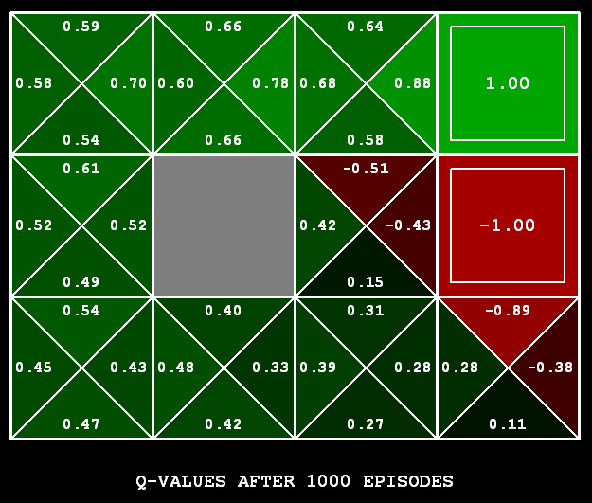
Q-Learning
Learn Q(s,a) values as you go
Receive a sample (s,a,s’,r)
Consider your old estimate: Q(s,a)
Consider your new sample estimate:
sample = R(s,a,s’) + γ max_{a’} Q(s’,a’)
Incorporate the new estimate into a running average:
Q(s,a) ← (1-α) Q(s,a) + α ⋅ [sample]
[Demo: Q-learning – gridworld (L10D2)]
[Demo: Q-learning – crawler (L10D3)]

Slide 39
Video of Demo Q-Learning -- Gridworld

Slide 40
Video of Demo Q-Learning -- Crawler

Slide 41
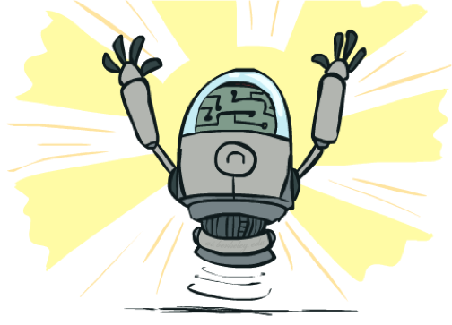
Q-Learning Properties
Amazing result: Q-learning converges to optimal policy -- even if samples are generated from a suboptimal policy!
This is called off-policy learning
Caveats:
You have to explore enough (eventually try every state/action pair infinitely often)
You have to decrease the learning rate appropriately
Technical requirements: ∑_{t} α(t) = ∞ , ∑_{t} α²(t) < ∞
Satisfied by: α(t) = 1/t or (better) α(t) = K/(K+t)

Slide 42
Summary
RL solves MDPs via direct experience of transitions and rewards
There are several schemes:
Learn the MDP model and solve it
Learn V directly from sums of rewards, or by TD local adjustments
Still need a model to make decisions by lookahead
Learn Q by local Q-learning adjustments, use it directly to pick actions
(and about 100 other variations)
Big missing pieces:
How to explore without too much regret?
How to scale this up to Tetris (10⁶⁰), Go (10¹⁷²), StarCraft (|A|=10²⁶)?

